Slide 1

Priority Queues and Heaps Data Structures-II
Dr. Dattatray G. Takale
Dattatray.takale@viit.ac.in
Department of Data Science
BRACT’S, Vishwakarma Institute of Information Technology, Pune-48
(An Autonomous Institute affiliated to Savitribai Phule Pune University)
(NBA and NAAC accredited, ISO 9001:2015 certified)

Slide 2
Unit -3 :Contents
Data Structures for Strings
String Searching: preliminaries, the DAWG, the position Heaps, tries and compressed tries, Suffix Trees and suffix arrays, Dictionaries Allowing Errors in Queries
Dr. Dattatray G Takale, Department of Computer Engineering, VIT, Pune-37

Slide 3
String
Definition: Preliminaries are the basic concepts and definitions of strings required to understand string searching algorithms and data structures.
Alphabet (Σ): A finite set of characters used to form strings. Examples: {A, B, C}, {0,1}, {A, C, G, T}
String: A sequence of characters from an alphabet. Example: DATA
Length of String: Number of characters in the string. Example: |DATA| = 4
Empty String: A string with no characters, denoted by ε.
Dattatray G Takale, Department of Computer engineering, VIT, Pune- 411037

Slide 4
Preliminaries Prefix, Suffix, and Substring
Prefix: Starting part of a string. Example: SEARCH → S, SE, SEA
Suffix: Ending part of a string. Example: SEARCH → H, CH, ARCH
Substring: Continuous sequence of characters inside a string. Example: COMPUTER → PUT
Subsequence: Characters in order but not necessarily continuous. Example: ABCD → AC
Dattatray G Takale, Department of Computer engineering, VIT, Pune- 411037

Slide 5
Preliminaries Prefix, Suffix, and Substring
Concatenation: Joining two strings. Example: DATA + BASE = DATABASE
Pattern Matching: Process of finding pattern P in text T. Example: Text: DATASTRUCTURE Pattern: DATA
Applications: • Search engines • Spell checkers • DNA sequence analysis • Text editors and data processing
Dattatray G Takale, Department of Computer engineering, VIT, Pune- 411037

Slide 6
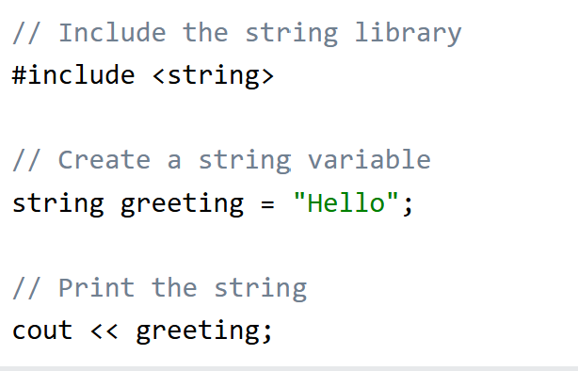
String
Strings are used for storing text/characters.
For example, "Hello World" is a string.
A string variable contains a collection of characters surrounded by double quotes (""):
string greeting = "Hello";
Dattatray G Takale, Department of Computer engineering, VIT, Pune- 411037

Slide 7
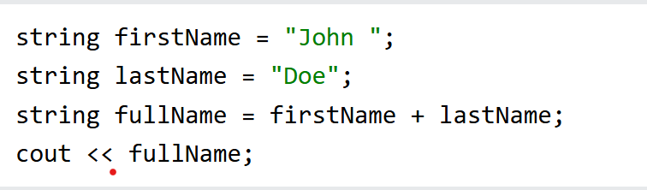
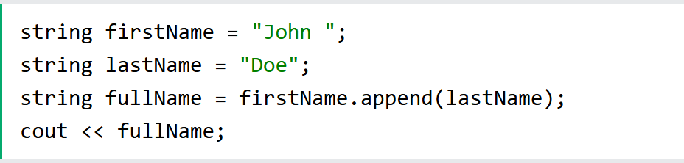
String
String Concatenation
The + operator can be used between strings to add them together to make a new string. This is called concatenation:
Append
A string in C++ is actually an object, which contain functions that can perform certain operations on strings. For example, you can also concatenate strings with the append() function:
Dattatray G Takale, Department of Computer engineering, VIT, Pune- 411037

Slide 8
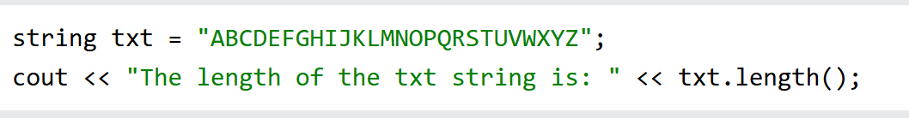
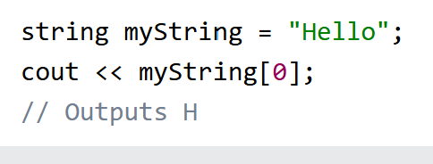
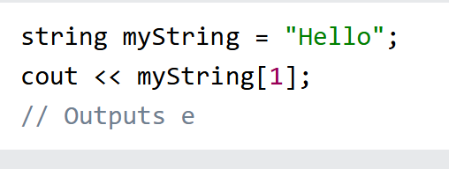
String
String Length
To get the length of a string, use the length() function:
Access Strings
You can access the characters in a string by referring to its index number inside square brackets [].
This example prints the first character in myString:
Dattatray G Takale, Department of Computer engineering, VIT, Pune- 411037

Slide 9
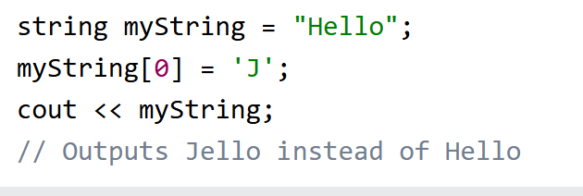
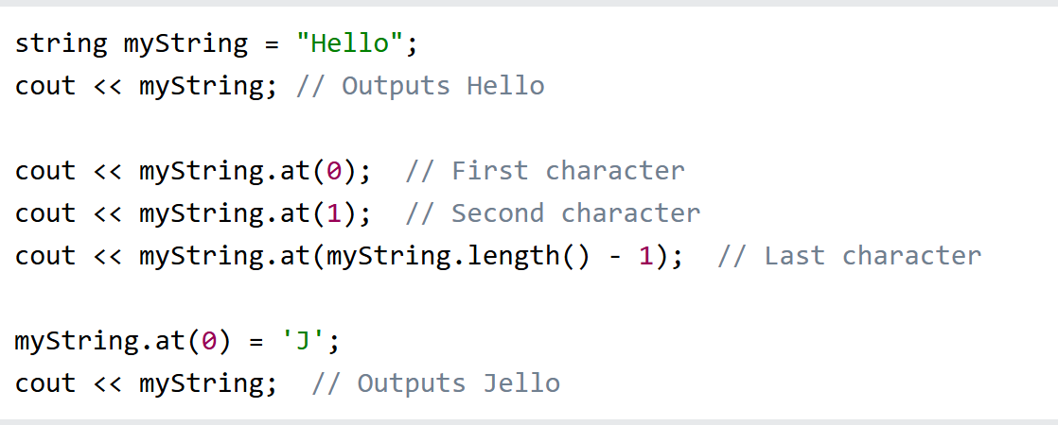
String
Change String Characters
To change the value of a specific character in a string, refer to the index number, and use single quotes:
The at() function
The <string> library also has an at() function that can be used to access characters in a string:
Dattatray G Takale, Department of Computer engineering, VIT, Pune- 411037

Slide 10
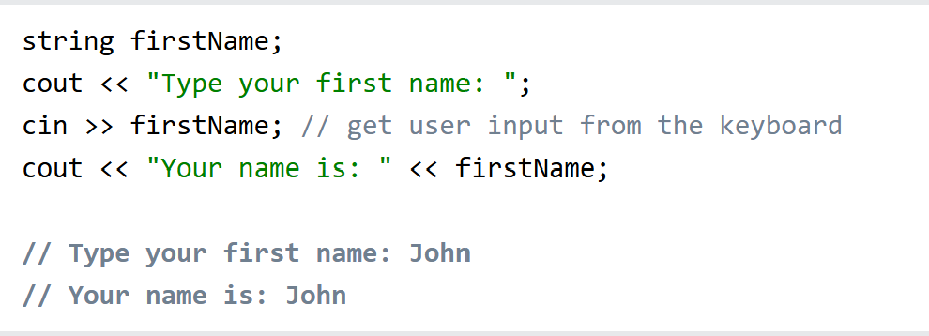
String
User Input Strings
It is possible to use the extraction operator >> on cin to store a string entered by a user:
Dattatray G Takale, Department of Computer engineering, VIT, Pune- 411037

Slide 11
Tries (Prefix Tree)
Definition: A Trie is a tree-based data structure used to be store and search strings efficiently. It is also called a Prefix Tree.
Key Features:
Each edge represents a character Each path from root represents a string or prefix
Common prefixes are stored only once
Example words: CAT, CAR, DOG
Dattatray G Takale, Department of Computer engineering, VIT, Pune- 411037

Slide 12
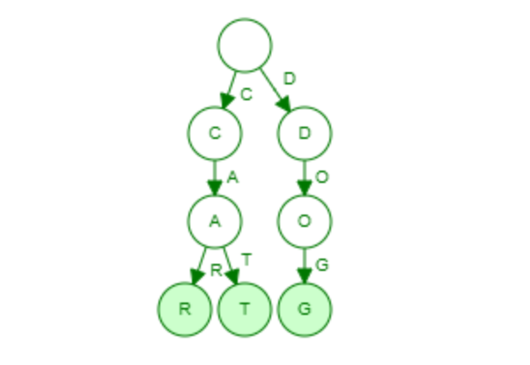
Tries (Prefix Tree)
Construction Steps:
Start from root node
Insert characters one by one
Create a new node if character does not exist
Mark end of word
Example: (CAT, CAR, DOG)
Dattatray G Takale, Department of Computer engineering, VIT, Pune- 411037

Slide 13
Tries (Prefix Tree)
Strings are sequences of characters from some alphabet. But for use in the computer, we need an important further information: how to recognize where the string ends.
There are two solutions for this:
We can have an explicit termination character, which is added at the end of each string, but may not occur within the string “\0” (ASCII code 0) , or
We can store together with each string its length.
Dattatray G Takale, Department of Computer engineering, VIT, Pune- 411037

Slide 14
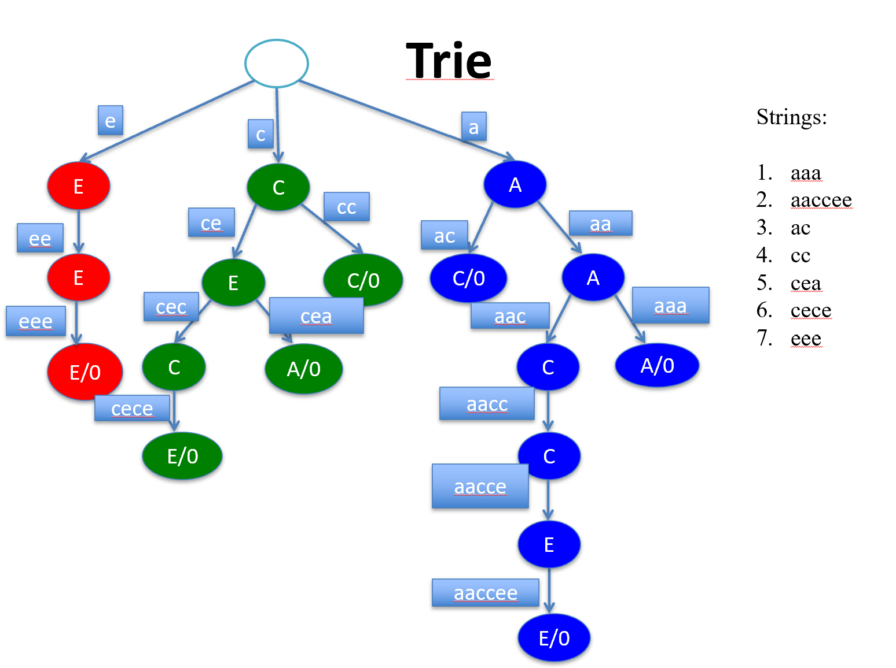
Tries (Prefix Tree)
Dattatray G Takale, Department of Computer engineering, VIT, Pune- 411037

Slide 15
Tries (Prefix Tree)
Tries Example
Example: standard trie for the set of strings
S = { bear, bell, bid, bull, buy, sell, stock, stop }
Dattatray G Takale, Department of Computer engineering, VIT, Pune- 411037

Slide 16
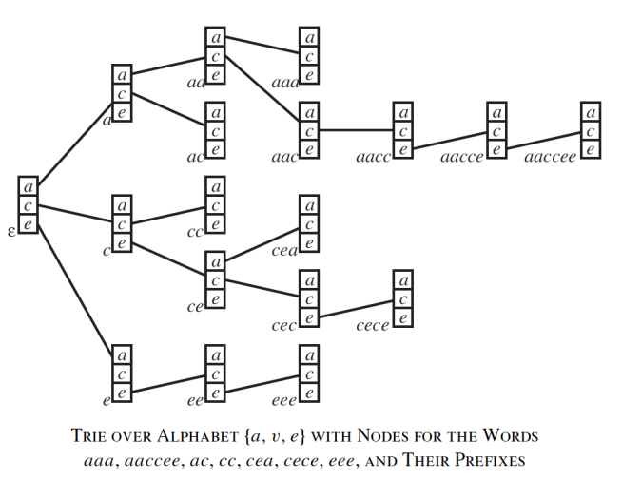
Tries (Prefix Tree)
Dattatray G Takale, Department of Computer engineering, VIT, Pune- 411037

Slide 17
Tries (Prefix Tree)
Advantages: • Fast searching time: O(m) • Efficient prefix searching • No duplicate storage of prefixes
Applications: • Dictionary storage • Autocomplete systems • Spell checking • Search engines
Dattatray G Takale, Department of Computer engineering, VIT, Pune- 411037

Slide 18
Compressed Tries(Radix Tree)
A Compressed Trie is an optimized version of a standard trie.
It compresses chains of single‑child nodes into one edge.
Each edge stores a string (substring) instead of a single character.
This reduces memory usage and improves efficiency.
Used in string searching, dictionaries, IP routing, and text indexing.
Key Idea: Merge nodes that have only one child to make the trie compact.
Dattatray G Takale, Department of Computer engineering, VIT, Pune- 411037

Slide 19
Compressed Tries(Radix Tree)
Problem with Standard Trie:
Standard trie stores one character per edge.
Creates many unnecessary intermediate nodes.
Wastes memory and space.
Traversal becomes longer.
Solution: Compressed Trie
Combines multiple characters into single edge labels.
Reduces number of nodes.
Improves search and storage efficiency.
Dattatray G Takale, Department of Computer engineering, VIT, Pune- 411037

Slide 20
Compressed Tries(Radix Tree)
Steps:
Start with a standard trie built from given strings.
Begin traversal from the root node.
For each node:
If the node has only one child and is not end of a word, → merge it with its child.
Combine the edge labels of merged nodes into a single label.
Continue this process recursively for all nodes.
Stop when every internal node has:
Either more than one child, or
Marks the end of a word.
Dattatray G Takale, Department of Computer engineering, VIT, Pune- 411037

Slide 21
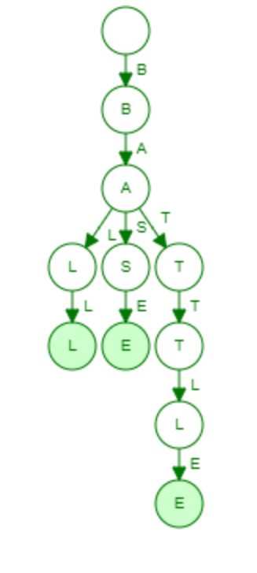
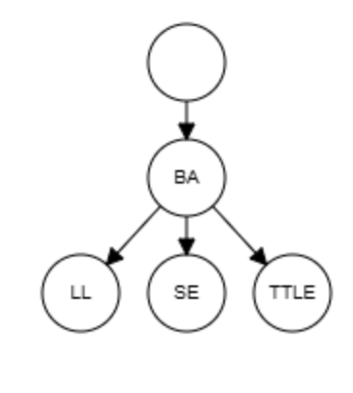
Compressed Tries(Radix Tree) Normal Tries VS Compressed Tries
Example: BATTLE, BALL, BASE
Compressed Tries Representation
Normal Tries Representation
Dattatray G Takale, Department of Computer engineering, VIT, Pune- 411037

Slide 22
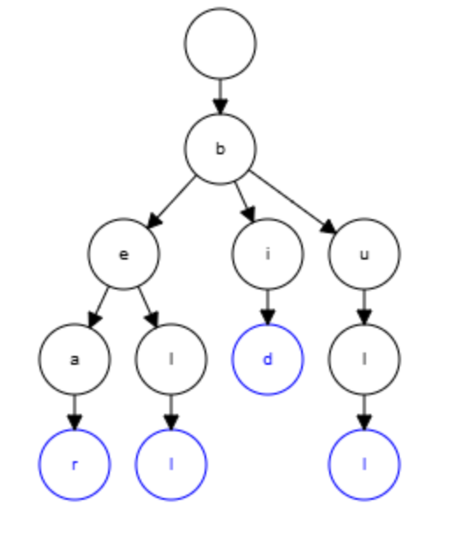
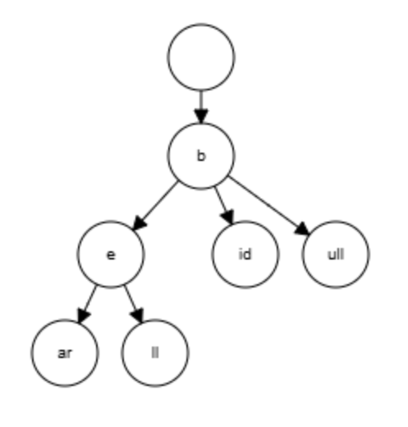
Compressed Tries(Radix Tree) Normal Tries VS Compressed Tries
Example: bear, bell, bid, bull
Normal Tries Representation
Compressed Tries Representation
Dattatray G Takale, Department of Computer engineering, VIT, Pune- 411037

Slide 23
Suffix Trees Definition
Definition: A Suffix Tree is a compressed trie that contains all suffixes of a given string.
A suffix is a substring that starts at any position and goes to the end of the string.
Example: String = BANANA$ Suffixes: BANANA$ ANANA$ NANA$ ANA$ NA$ A$ $
Key Idea: All suffixes are stored in one tree for fast pattern searching.
Dattatray G Takale, Department of Computer engineering, VIT, Pune- 411037

Slide 24
Suffix Trees Properties
Properties: • Root represents empty string • Each edge has substring label • Each leaf represents one suffix • No two edges from same node start with same character • It is a compressed trie
Dattatray G Takale, Department of Computer engineering, VIT, Pune- 411037

Slide 25
Suffix Trees Algorithm
Input: String S of length n
Steps:
Add terminal symbol $
Generate all suffixes
Insert each suffix from root
If mismatch → create new edge
If partial match → split edge
Store substrings on edges (compression)
Dattatray G Takale, Department of Computer engineering, VIT, Pune- 411037

Slide 26
Suffix Trees Example
Example: BANANA
1. Insert $ suffixes of BANANA$
2. Generate all suffixes
BANANA$ ANANA$ NANA$ ANA$ NA$ A$ $
Dattatray G Takale, Department of Computer engineering, VIT, Pune- 411037

Slide 27
Suffix Trees Example
3. Insert each suffix into compressed trie
Step 1: Insert BANANA$ Step 2: Insert ANANA$
Step 3: Insert NANA$ Step 4: Insert ANA$
(root) | BANANA$
(root) ├── BANANA$ └── ANANA$
(root) ├── BANANA$ ├── ANANA$ └── NANA$
(root) ├── BANANA$ ├── ANA │ ├── NA$ │ └── $ └── NANA$
Dattatray G Takale, Department of Computer engineering, VIT, Pune- 411037

Slide 28
Suffix Trees Example
Step 5: Insert NA$ Step 6: Insert A$ Step 7: Insert $
(root) ├── BANANA$ ├── ANA │ ├── NA$ │ └── $ └── NA ├── NA$ └── $
(root) ├── BANANA$ ├── A │ ├── NA │ │ ├── NA$ │ │ └── $ │ └── $ └── NA ├── NA$ └── $
(root) ├── BANANA$ ├── A │ ├── NA │ │ ├── NA$ │ │ └── $ │ └── $ ├── NA │ ├── NA$ │ └── $ └── $
Dattatray G Takale, Department of Computer engineering, VIT, Pune- 411037

Slide 29
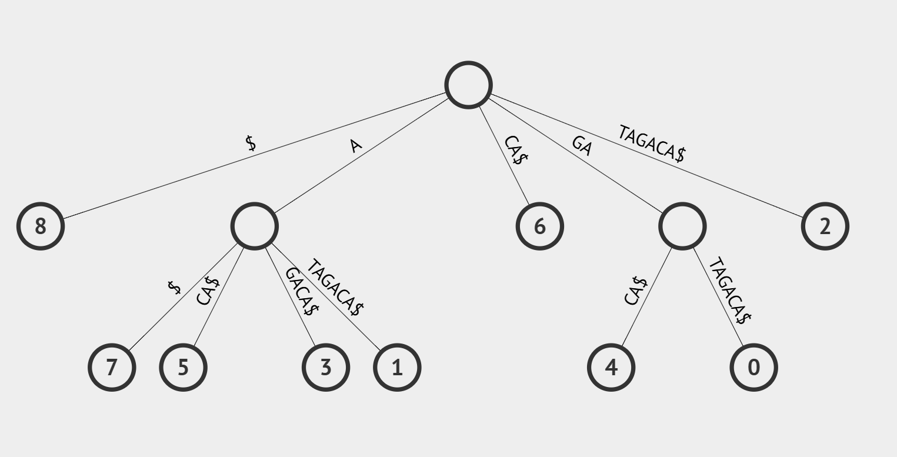
Suffix Trees Example
Example 2: Insert GATAGACA$
Dattatray G Takale, Department of Computer engineering, VIT, Pune- 411037

Slide 30
Suffix Trees Advantages, Application
Construction: Basic method: O(n²) Search: O(m) Space: O(n)
Advantages:
• Fast pattern searching ⚡ • Finds substring in linear time • Finds repeated substrings • Finds longest common substring
Applications:
• Text searching (Google search) • DNA sequence analysis • Plagiarism detection • Data compression • Bioinformatics
Dattatray G Takale, Department of Computer engineering, VIT, Pune- 411037

Slide 31
Suffix Array Definition
Definition: “A Suffix Array is a sorted array of all suffixes of a given string. Instead of storing the suffixes themselves, it stores the starting indices of suffixes in lexicographical (alphabetical) order.”
Key Idea: • Store positions of suffixes • Sort suffixes alphabetically • Use indices for efficient searching
Dattatray G Takale, Department of Computer engineering, VIT, Pune- 411037

Slide 32
Suffix Array Example
Example String: BANANA$
Suffixes:
0 → BANANA$ 1 → ANANA$ 2 → NANA$ 3 → ANA$ 4 → NA$ 5 → A$ 6 → $
Sorted Suffixes:
6 → $
5 → A$
3 → ANA$
1 → ANANA$
0 → BANANA$ 4 → NA$
2 → NANA$
Suffix Array = [6, 5, 3, 1, 0, 4, 2]
This array represents positions of sorted suffixes.
Dattatray G Takale, Department of Computer engineering, VIT, Pune- 411037

Slide 33
Suffix Array Applications
Applications:
• Fast pattern searching • Text indexing • Bioinformatics (DNA matching) • Data compression • Replaces suffix tree (uses less memory)
Advantages over Suffix Tree:
• Less memory • Easy to implement • Efficient searching using binary search
Dattatray G Takale, Department of Computer engineering, VIT, Pune- 411037

Slide 34
DAWG (Directed Acyclic Word Graph) Definition
Definition:
“A Directed Acyclic Word Graph (DAWG) is a compressed finite automaton that represents all substrings or suffixes of a string efficiently by merging equivalent states.”
Key points: • Directed graph • No cycles (Acyclic) • Compact representation of suffix trie • Removes duplicate paths • Saves memory compared to trie
Purpose: Efficient string searching and pattern matching.
Dattatray G Takale, Department of Computer engineering, VIT, Pune- 411037

Slide 35
DAWG (Directed Acyclic Word Graph) Definition
Definition:
“A Directed Acyclic Word Graph (DAWG) is a compressed finite automaton that represents all substrings or suffixes of a string efficiently by merging equivalent states.”
Key points: • Directed graph • No cycles (Acyclic) • Compact representation of suffix trie • Removes duplicate paths • Saves memory compared to trie
Purpose: Efficient string searching and pattern matching.
Dattatray G Takale, Department of Computer engineering, VIT, Pune- 411037

Slide 36
DAWG Purpose
Problem with Trie / Suffix Trie:
• Uses too much memory • Repeated substrings create duplicate branches
Example: BANANA
Substring "ANA" appears multiple times → trie stores repeatedly
DAWG solution: Merge identical suffixes → reduce nodes and edges
Dattatray G Takale, Department of Computer engineering, VIT, Pune- 411037

Slide 37
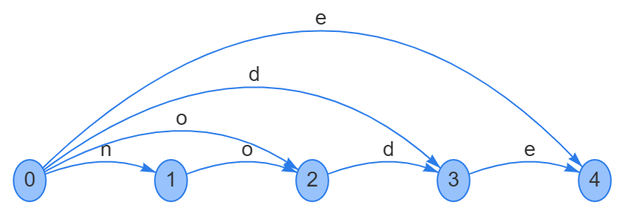
DAWG Structure of DAWG
Components:
• Nodes (States) → represent substrings • Edges → labeled with characters • Start node → empty string • Final nodes → represent valid suffixes
Properties:
• Directed graph • No cycles • Minimal automaton • Each substring represented once • Number of states ≤ 2n − 1 • Space complexity: O(n)
node DAWG
Dattatray G Takale, Department of Computer engineering, VIT, Pune- 411037

Slide 38
DAWG Structure of DAWG
Components:
• Nodes (States) → represent substrings • Edges → labeled with characters • Start node → empty string • Final nodes → represent valid suffixes
Properties:
• Directed graph • No cycles • Minimal automaton • Each substring represented once • Number of states ≤ 2n − 1 • Space complexity: O(n)
Dattatray G Takale, Department of Computer engineering, VIT, Pune- 411037

Slide 39
DAWG Construction DAWG from given word suffixes
Input: String S of length n
Output:
DAWG representing all substrings (all suffixes included) of S
At each step:
Add new substrings ending at the current character
Merge equivalent states
Maintain suffix links
Dattatray G Takale, Department of Computer engineering, VIT, Pune- 411037

Slide 40
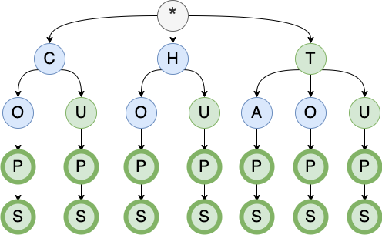
DAWG Construct DAWG from Tries
Build a DAWG with the following words: COP, COPS, CUP, CUPS, HOP, HOPS, HUP, HUPS, TAP, TAPS, TOP, TOPS, TUP, TUPS.
Step1: Construct Tries for given words

Slide 41
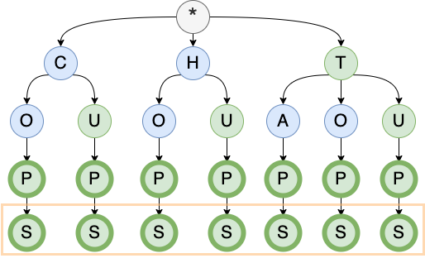
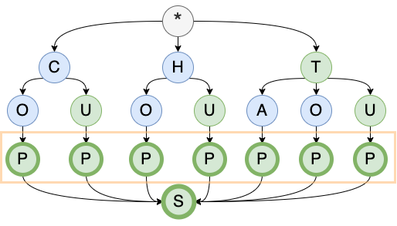
DAWG Construct DAWG from Tries
Step2: Merging nodes (Starting from the bottom)
Merge ‘S’
Dattatray G Takale, Department of Computer engineering, VIT, Pune- 411037

Slide 42
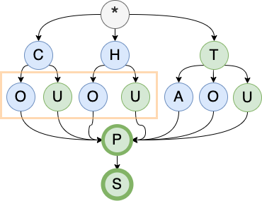
DAWG Construct DAWG from Tries
Step2: Merging nodes (Starting from the bottom)
Merge ‘P’
Dattatray G Takale, Department of Computer engineering, VIT, Pune- 411037

Slide 43
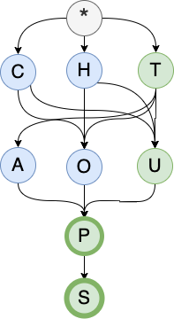
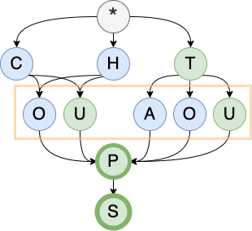
DAWG Construct DAWG from Tries
Step2: Merging nodes (Starting from the bottom)
Merge ‘O and U node Pairs’
Dattatray G Takale, Department of Computer engineering, VIT, Pune- 411037

Slide 44

DAWG Construct DAWG from Tries
Step3: Store it as an array
Dattatray G Takale, Department of Computer engineering, VIT, Pune- 411037

Slide 45
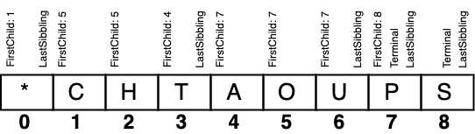
DAWG Construct DAWG from Tries
Step3: Final Representation
Dattatray G Takale, Department of Computer engineering, VIT, Pune- 411037

Slide 46
Dictionaries Allowing Errors in Queries
Users often make spelling mistakes
Example: aple → apple
System should still return correct result
Dattatray G Takale, Department of Computer engineering, VIT, Pune- 411037

Slide 47
Dictionary Concept
Dictionary stores words
Operations: Insert, Search, Delete
Example: apple, banana, cat
Dattatray G Takale, Department of Computer engineering, VIT, Pune- 411037

Slide 48
Problem with Exact Matching
Search requires exact match
Example: appl → Not Found
Dattatray G Takale, Department of Computer engineering, VIT, Pune- 411037

Slide 49
Allowing Errors
System finds similar words even with mistakes
Dattatray G Takale, Department of Computer engineering, VIT, Pune- 411037

Slide 50
Types of Errors
Insertion: applle → apple
Deletion: aple → apple
Substitution: cap → cat
Transposition: act → cat
Dattatray G Takale, Department of Computer engineering, VIT, Pune- 411037

Slide 51
Edit Distance
Minimum operations to convert one word into another
Example: aple → apple = 1
Dattatray G Takale, Department of Computer engineering, VIT, Pune- 411037

Slide 52
Example of Edit Distance
cat → cut (replace 'a' with 'u')
Edit Distance = 1
Dattatray G Takale, Department of Computer engineering, VIT, Pune- 411037

Slide 53
Example Dictionary
Words: cat, bat, rat, mat
Search: hat
Output: cat, bat, rat, mat
Dattatray G Takale, Department of Computer engineering, VIT, Pune- 411037

Slide 54
Techniques Used
Trie with error tolerance
Dynamic Programming
BK-Tree
Automata
Dattatray G Takale, Department of Computer engineering, VIT, Pune- 411037

Slide 55
Trie Method
Traverse Trie and allow mismatches
Used in autocomplete systems
Dattatray G Takale, Department of Computer engineering, VIT, Pune- 411037

Slide 56
Advantages
Handles mistakes
Improves search
User-friendly
Disadvantage
More computation
Complex implementation
Application
Spell checker
Search engines
Autocomplete
DNA matching
Dattatray G Takale, Department of Computer engineering, VIT, Pune- 411037

